Slide 1
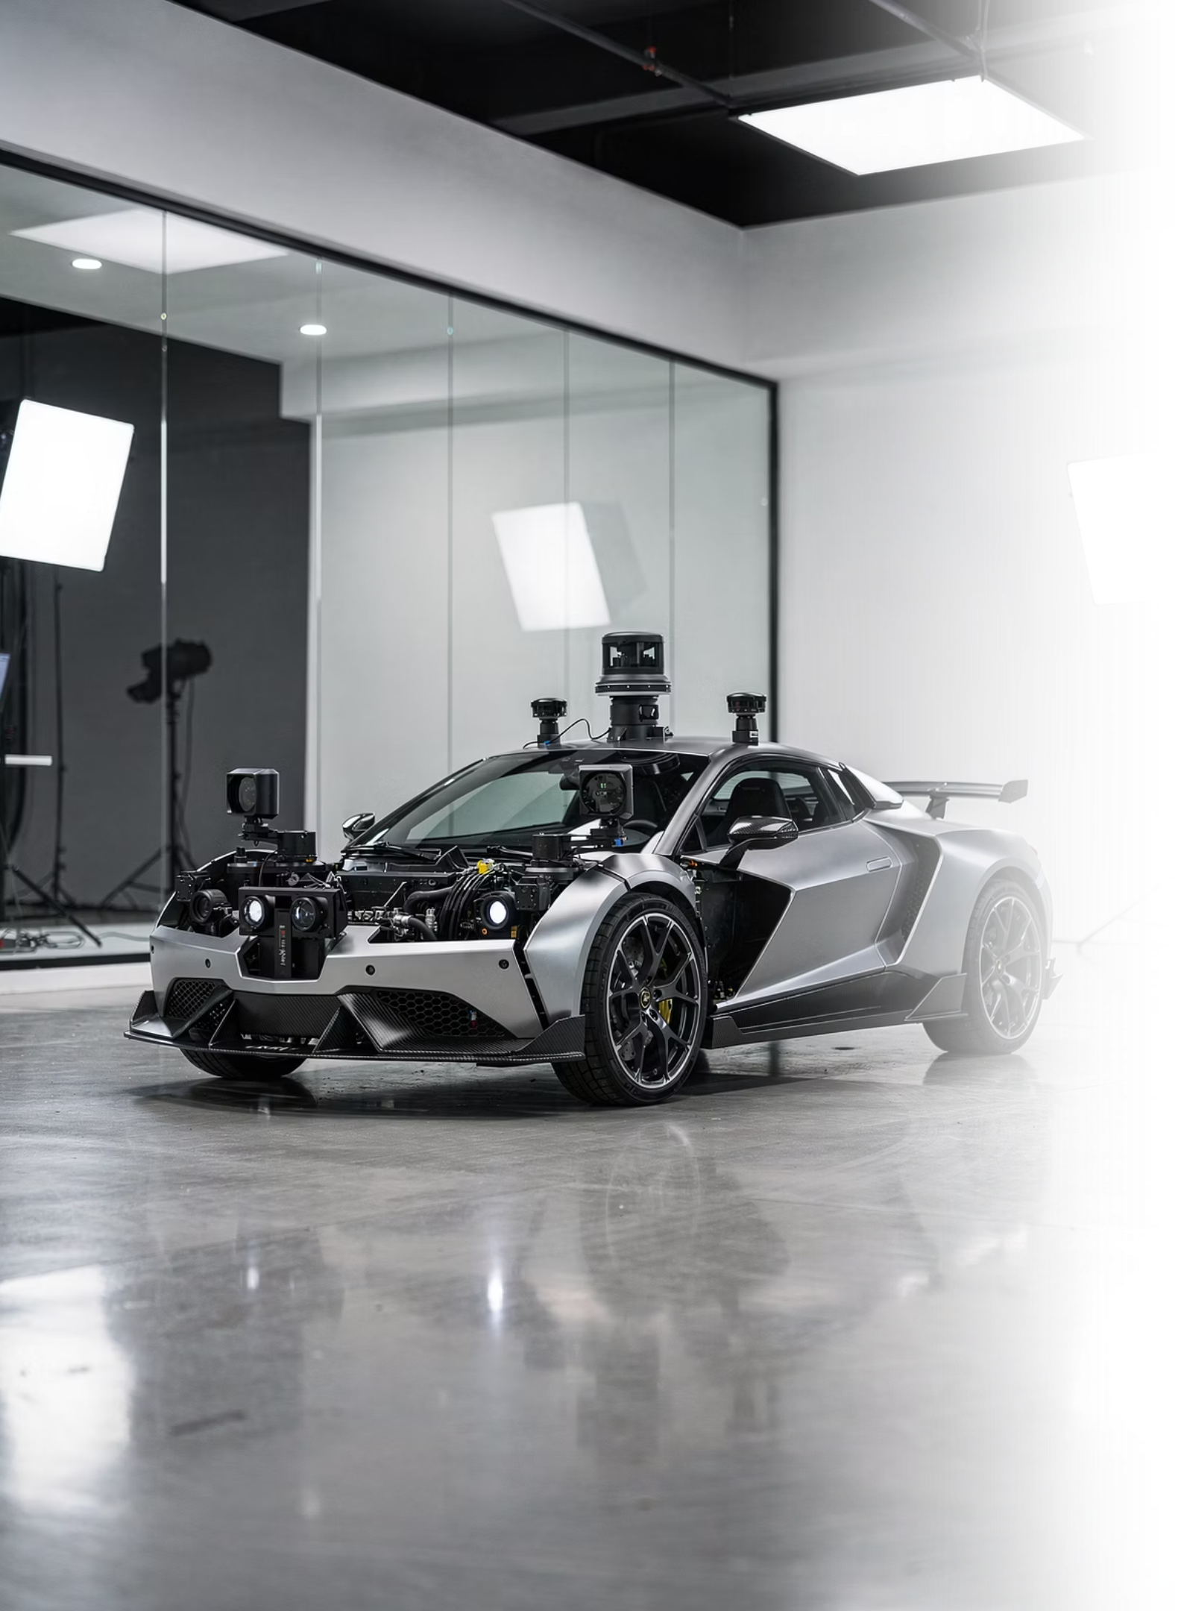
Picar Robot
Designing intelligent navigation systems for small-scale autonomous ground vehicles

Slide 2

Project Goals & Problem Statement
Primary Objective
Real-World Challenge
Design and implement an autonomous Picar robot capable of navigating its environment using sensors and intelligent control systems
Enable a small-scale robotic vehicle to perceive surroundings, avoid obstacles, and follow planned paths with minimal human intervention
Project Objectives
Build a functional robotic platform
Implement perception, planning, and control algorithms
Integrate hardware and software components
Evaluate performance through structured testing
Key Constraints: Limited battery life, sensor accuracy limitations, small form factor, and computational limits of onboard hardware

Slide 3
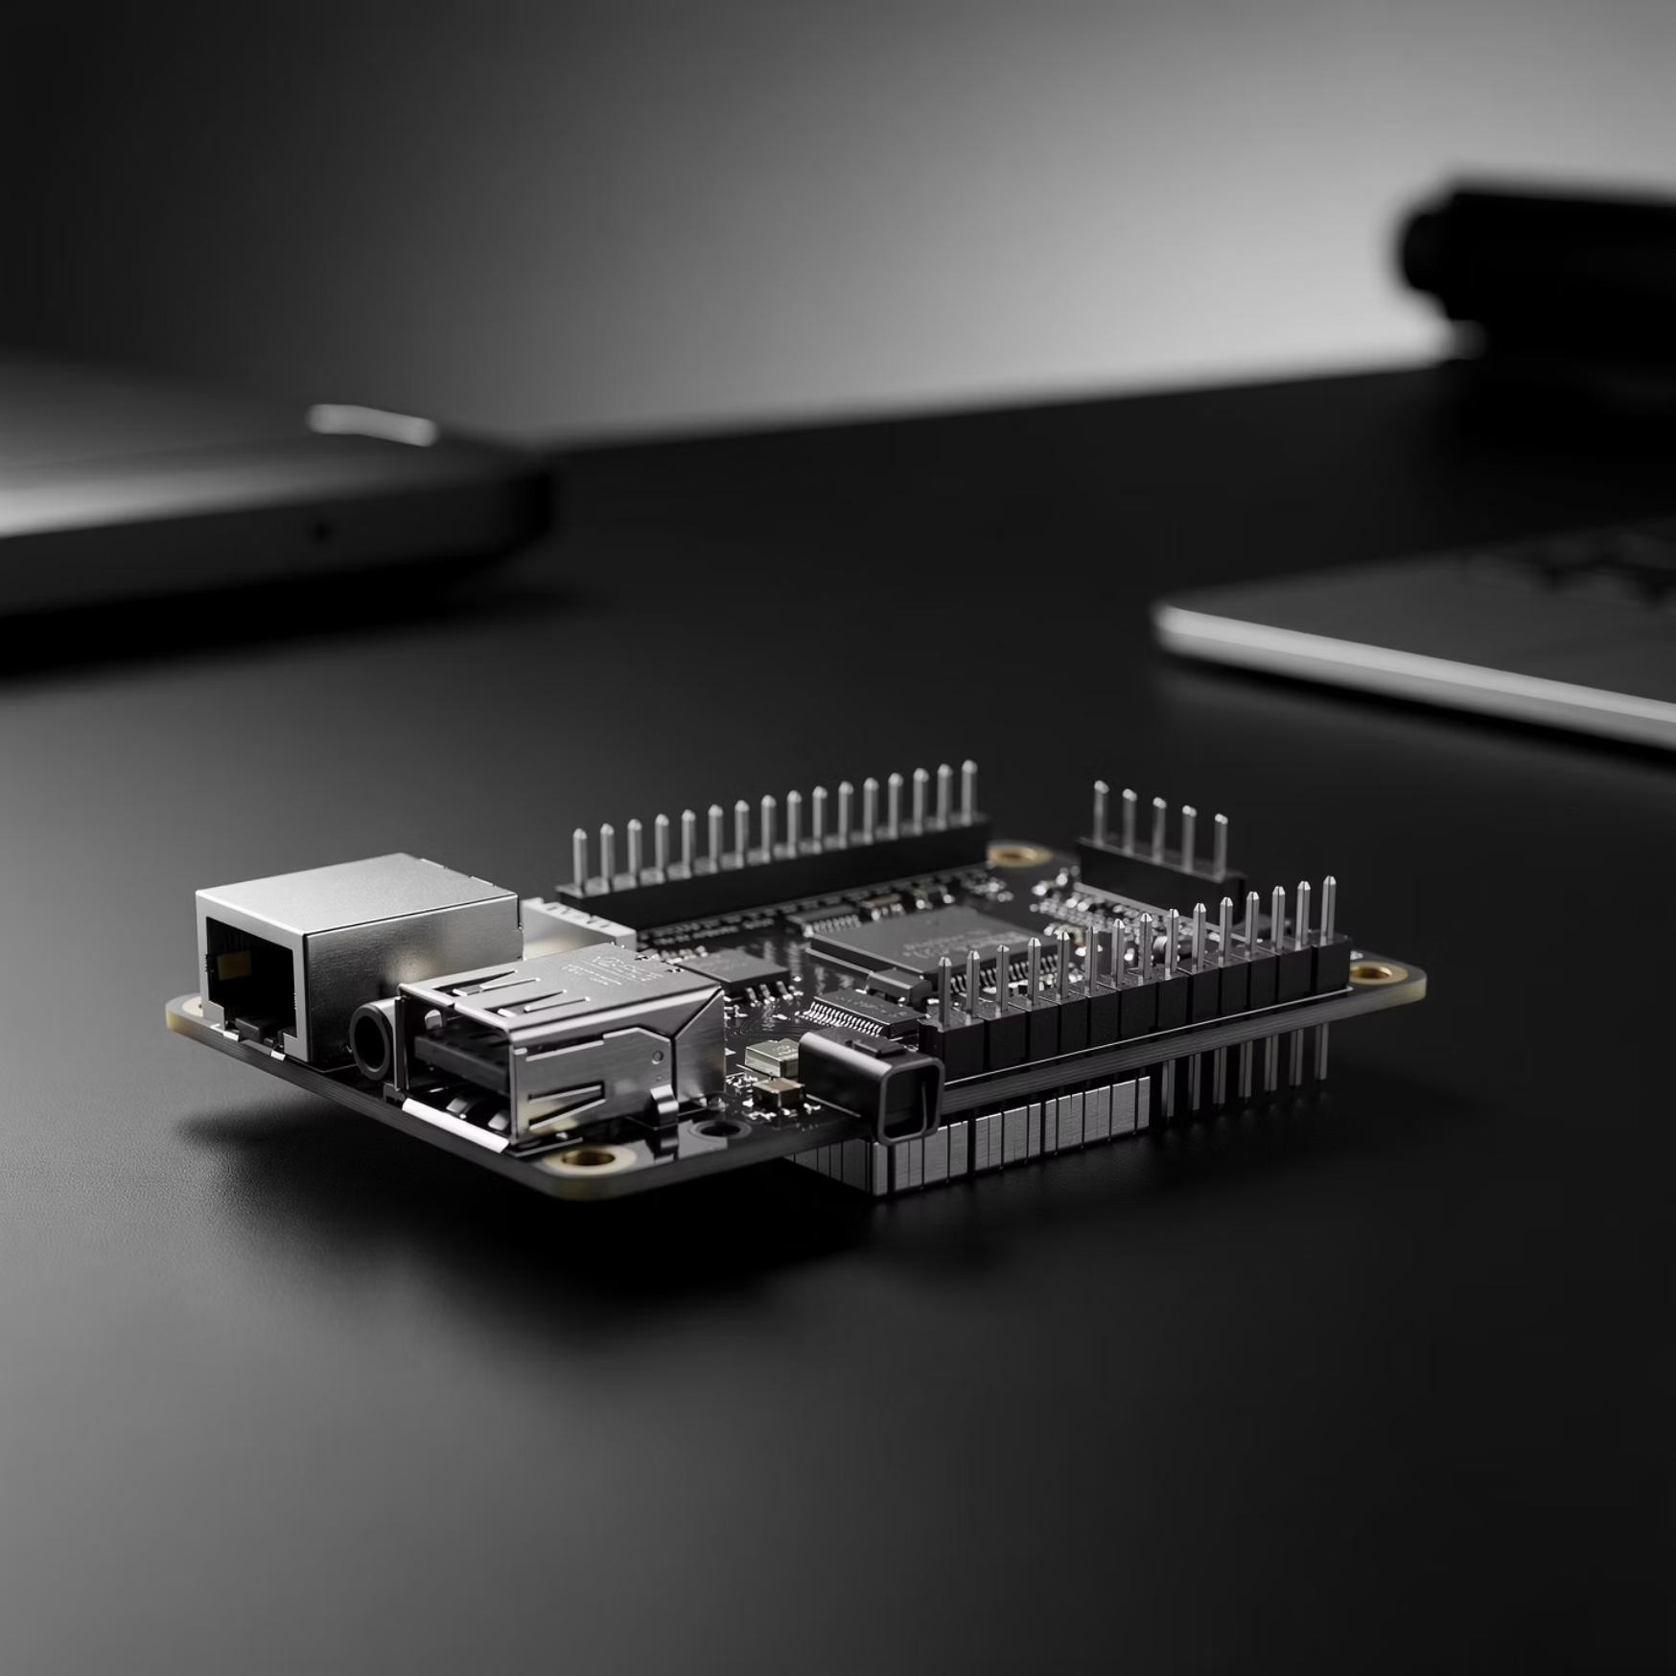
System Design Overview
Hardware Components
Software Components
Raspberry Pi (main controller)
Raspberry Pi OS or minimal Linux-based OS
Motor driver board (L298N or equivalent)
Python as main programming language
Servo motor for steering
OpenCV for image processing
DC motors for propulsion
GPIO libraries for motor/sensor control
Ultrasonic sensor for obstacle detection
Custom navigation and control scripts
IR/line-following sensors (optional)
Camera module for visual input
Chassis, wheels, and Li-ion battery pack

Slide 4






System Architecture
The robot architecture follows a linear data flow model from sensing to actuation, processing information through discrete computational stages.
Sensors
Raw environmental data capture
Sensors
Perception
Data interpretation and feature extraction
Planning
Decision-making and path generation
Control
Processing
Signal conversion to motor commands
Movement
Physical actuation and navigation
Control Output
Actuation

Slide 5
Perception Algorithms
Perception transforms raw sensor data into meaningful environmental information that the robot can use for decision-making. The system must convert physical phenomena into numerical representations.
1
2
3
Ultrasonic Sensor Processing
Line/IR Sensor Processing
Camera-Based Vision
Measures obstacle distance using trigger and echo timing. Sound pulses reflect off objects, and time-of-flight calculations determine distance to obstacles in the forward path.
Detects contrast between track surface and background. Provides real-time classification of positional deviation (left, center, or right) for line-following tasks.
Implements edge detection, line tracking, or color segmentation using OpenCV. Requires careful threshold tuning for different lighting conditions and environments.
Key principle: The robot must "see" using numbers, not images. All visual information is converted into quantifiable data points for computational processing.

Slide 6
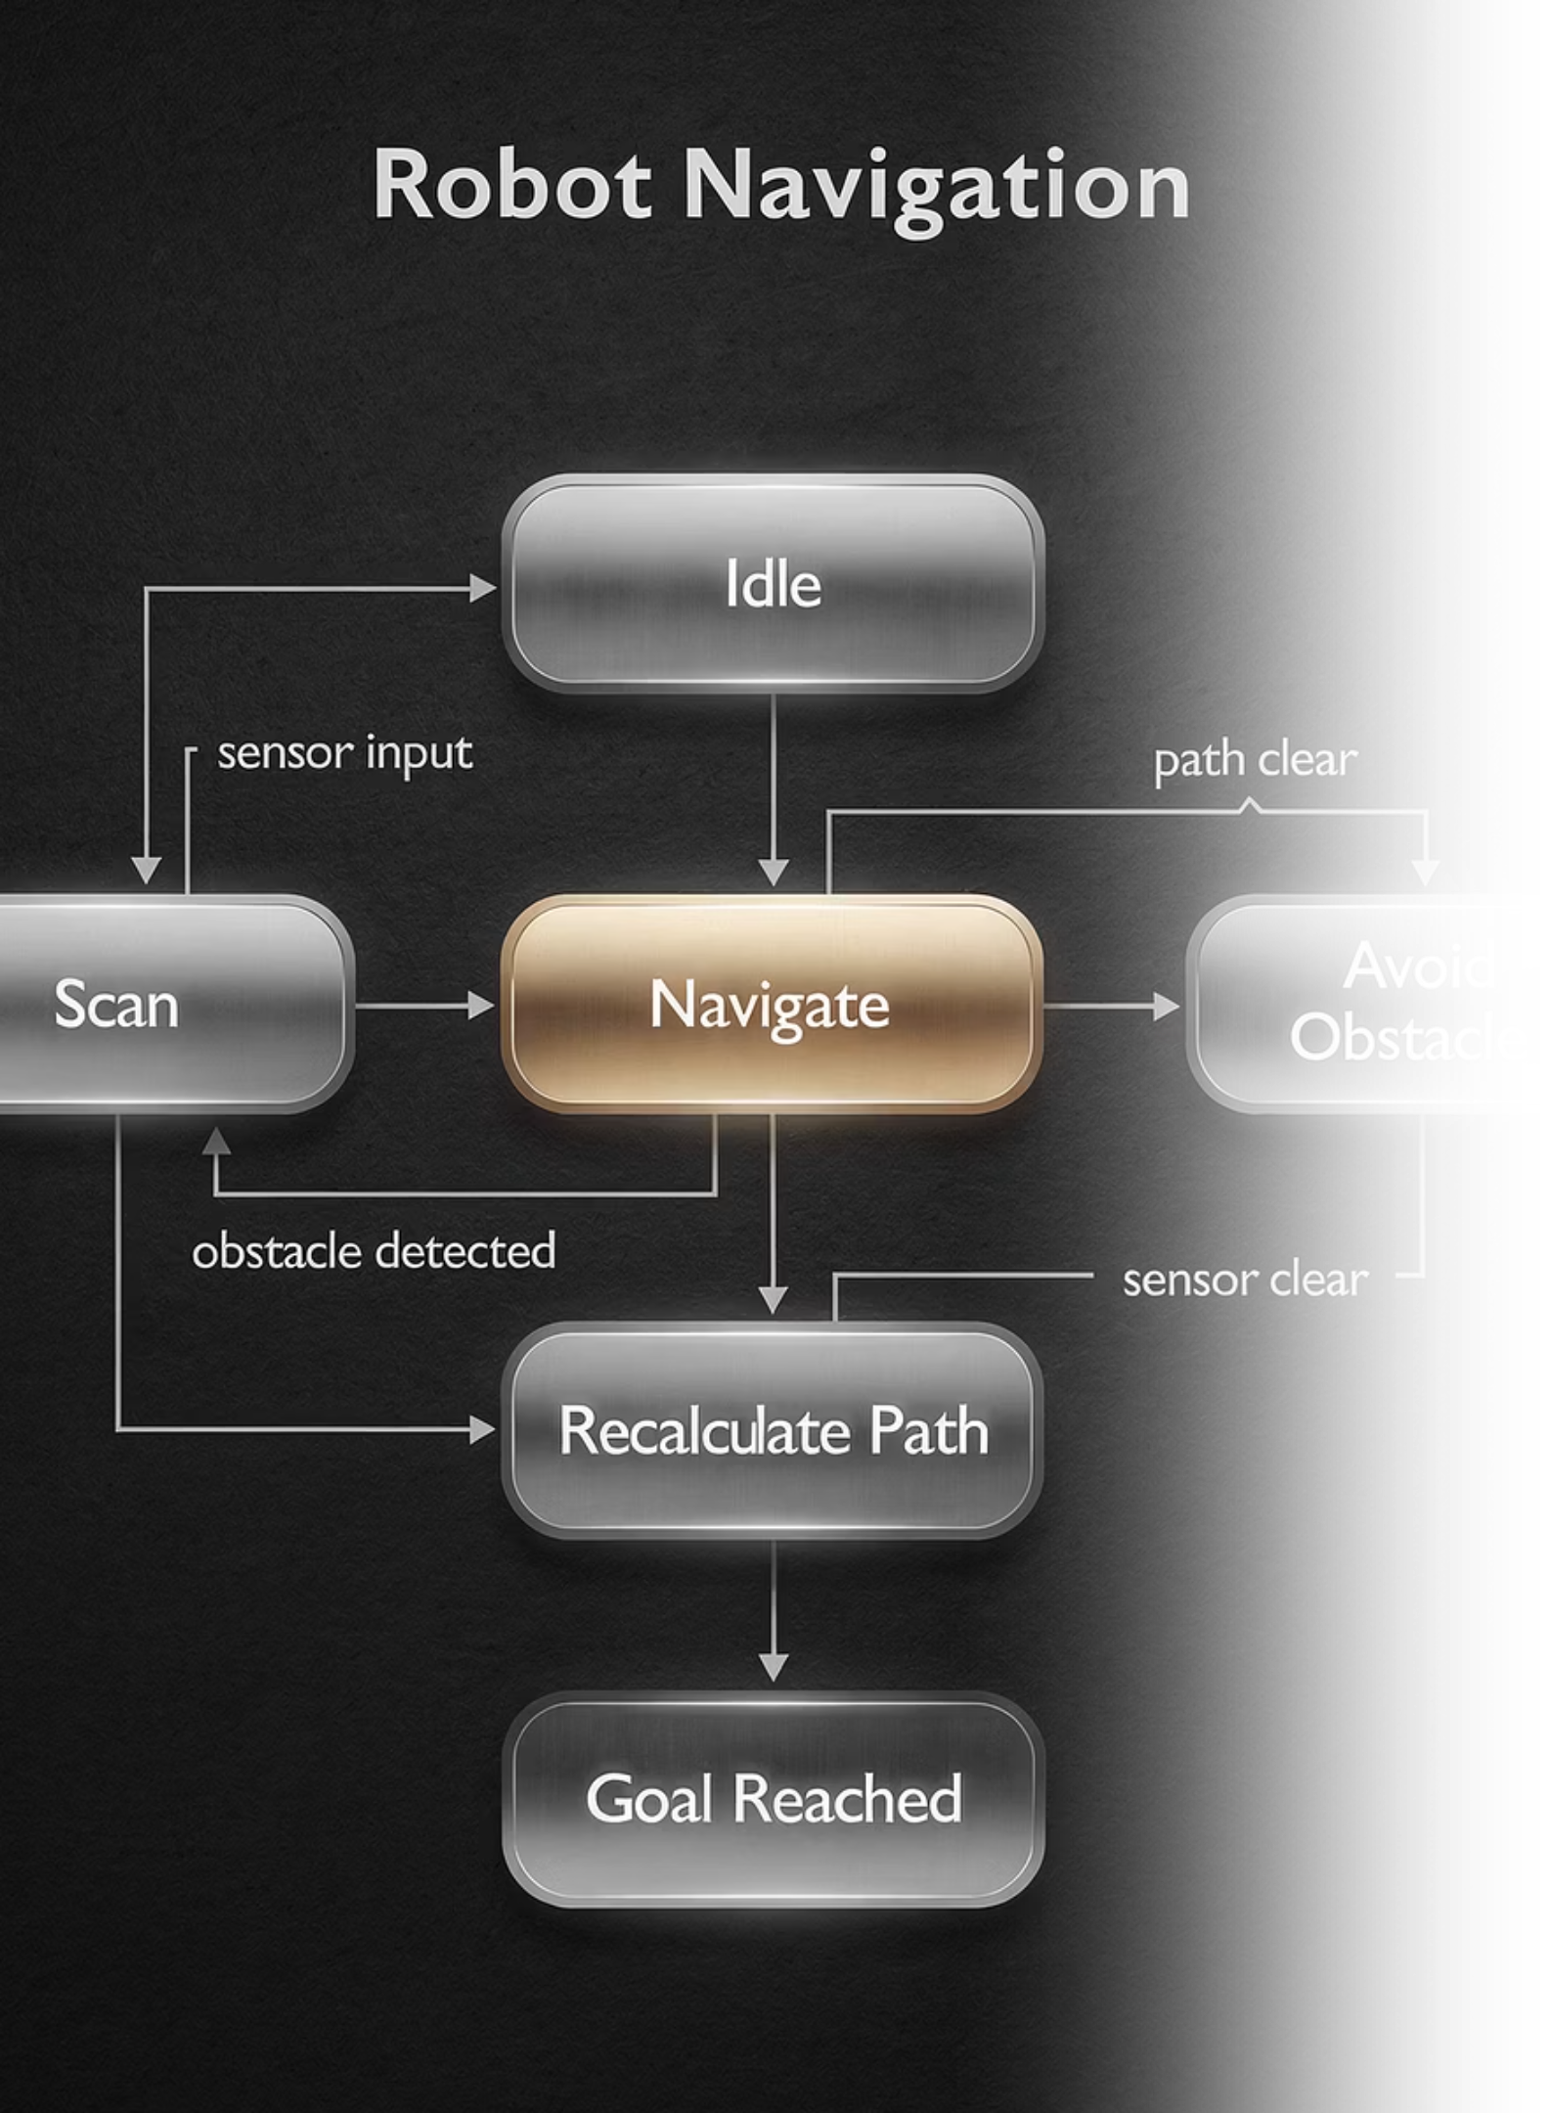
Planning Algorithms
Planning algorithms bridge perception and action, deciding the robot's next movement based on interpreted sensor data. This layer implements the decision-making logic that enables autonomous behavior.
Rule-Based Decision Logic
Finite State Machine
Path Planning
Basic navigation strategy implementation:
Simple conditional statements drive immediate responses:
Discrete operational states with defined transitions:
Straight-line trajectory generation
States: Searching, Following, Avoiding, Idle
If obstacle < X cm → stop or turn
Simple turn logic based on environmental cues
If line detected on left → steer left
Triggers: Sensor threshold crossings
Waypoint-based goal seeking
If path clear → proceed forward
Behavior: Predictable state-based actions
Planning ensures predictable and repeatable decision-making across varying environmental conditions, enabling consistent autonomous operation.

Slide 7
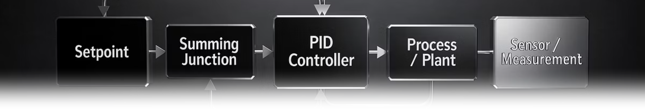



Control Algorithms
Control algorithms translate high-level planning decisions into precise physical movements through motor commands and servo positioning.
Motor Control
Steering Control
PID Controller
PWM signals regulate speed and direction
Servo angle calibration for directional changes
Proportional-Integral-Derivative tuning
Forward and reverse motion
Left position angle
Reduces oscillations during line following
Variable speed control
Center/straight position
Maintains smoother motion profiles
Electronic braking
Right position angle
Minimizes steady-state error
The control layer ensures stable and accurate movement by continuously adjusting motor outputs based on feedback from planning decisions and sensor inputs.

Slide 8
Testing Process
Rigorous testing under varying conditions validated system performance and identified areas requiring calibration adjustments.
01
02
Straight-Line Driving Tests
Obstacle Detection & Avoidance
Evaluated motor synchronization and trajectory stability over measured distances
Assessed sensor accuracy and response timing when encountering barriers
03
04
Steering Accuracy Tests
Line-Following Lane Stability
Measured servo precision and turning radius consistency
Analyzed tracking performance on high-contrast paths
Data Collection Methods
Distance logs from ultrasonic sensors
Error rate calculations for path deviation
Visual inspection of navigation behavior
Timestamp analysis for response latency
Multiple trials were conducted under varying lighting conditions and floor surface types. Collected data informed iterative adjustments to sensor thresholds, motor speeds, and decision rule parameters.

Slide 9
Lessons Learned
Sensor Calibration is Critical
Environmental Factors Matter
Integration Requires Iteration
Consistent results depend on precise threshold tuning for each sensor type. Environmental variations require adaptive calibration strategies rather than fixed parameters.
Lighting conditions and surface texture significantly affect perception accuracy. Robust systems must account for variability through adaptive algorithms or comprehensive testing.
Hardware-software integration involves extensive troubleshooting. Modular design and systematic debugging accelerate the development process.
PID Tuning Takes Time
Simplicity Often Wins
Eliminating drift and wobble requires careful proportional, integral, and derivative parameter adjustment through empirical testing and refinement.
On resource-constrained platforms, simpler rule-based logic frequently outperforms complex algorithms due to reduced computational overhead and faster execution.
This project highlighted the importance of test-driven development in robotics. Iterative refinement based on empirical data proved essential for achieving reliable autonomous behavior.

Slide 10





Ethical Considerations in Autonomous Robotics
Even small-scale educational robots raise important ethical questions that engineers must consider throughout the development lifecycle.
Safety
Data Privacy
Autonomous robots must operate safely to avoid harm to people and property. Fail-safe mechanisms and emergency stop procedures are essential design requirements.
Camera-based perception systems raise privacy concerns when deployed in public or shared spaces. Data handling protocols must respect individual privacy rights.
Bias & Reliability
Responsible Deployment
Sensor failures or algorithmic limitations can lead to unintended actions. Systems must degrade gracefully and provide clear operational status indicators.
Even small robots require extensive testing before real-world use. Developers bear responsibility for anticipating edge cases and potential misuse scenarios.
Educational Imperative: Robotics education should encourage ethical thinking alongside engineering skills, preparing students to develop responsible autonomous systems.

Slide 11
Conclusion: Picar Robot Journey
This project successfully demonstrated autonomous navigation for the Picar Robot, integrating perception, planning, and control algorithms to achieve reliable environmental interaction.
We gained invaluable insights into sensor calibration, environmental adaptability, and the iterative nature of robotics development, validating our approach through rigorous testing.
Future iterations can explore advanced AI, multi-robot coordination, and deployment in more complex real-world applications, building upon this foundational success.

